Slide 1



Data Science and Machine Learning
BASIC CONSULTING READINESS

Slide 2

Why?
In a perfect world, you would get clear metrics and well tough out hypotheses to validate, but the exploratory nature of data analysis means that you will often be the front line in data interpretation.
In this presentation we will cover two concepts to empower your data analytics career
Answer 1st - Think business to generate powerful hypotheses
80/20 - Prioritization and focus on impact

Slide 3
The two pillars
Answer First
80/20
Start from the objective and identify relevant drivers
- Great to generate hypotheses that actually matter - Categorize and narrow down where DA/AI can add value
- Ballpark before you start
Prioritize ruthlessly and add complexity only when essential
- Focus on solving (parts of) issues that need to be solved - Spend your resources (usually time) wisely to generate the best solution

Slide 4
ANSWER FIRST

Slide 5
Answer First and Issue Trees
Start with a best-effort “solution” to what you want to achieve.
Break down the drivers of that solution, then break down the drivers of those drivers and so on
Make a rough estimation of the size and relative impact of each driver
e.g the profitability framework
Number clients
Items sold
Revenue
Orders / client
Price per item
Profitability
Fixed costs
Cost
Variable costs

Slide 6
Answer First and Issue Trees
Applied to data analytics
Focus on the leaves!
Profitability example
Oil carrier example
Not all nodes are going to be for DA/DS to handle
Relate to 80/20 and weight
Identify critical paths and define alternatives and assumptions (PM)
Ballpark to start!
Blocking analyses and impacts

Slide 7
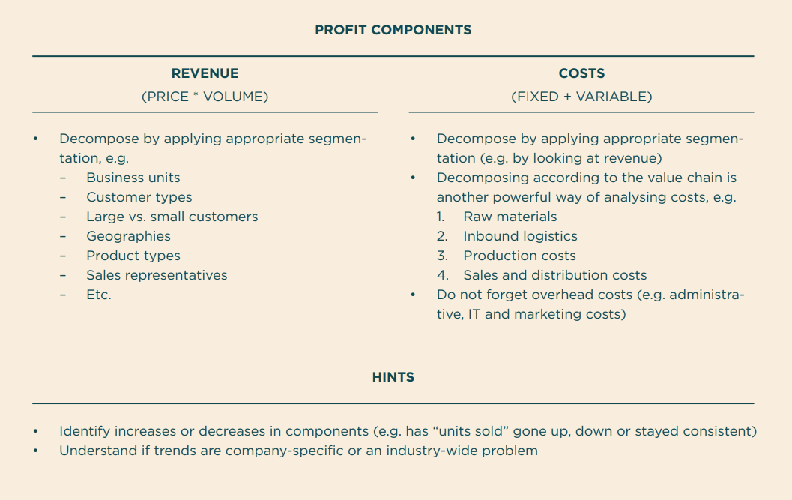
Profitability framework
The profitability framework helps you to systematically break down the profitability drivers.
Your goal is often to isolate significant historic developments (e.g. the cost of raw material has been surging), benchmark profitability drivers with competitors (e.g. our prices are lower than our peers) and evaluate opportunities (e.g. is it possible for us to increase profits by boosting sales of product A?).
The key to solving these cases is often to understand the underlying mechanics that produce the eventual anomalies in the numbers.
Think of different ways to segment costs and revenue.

Slide 8
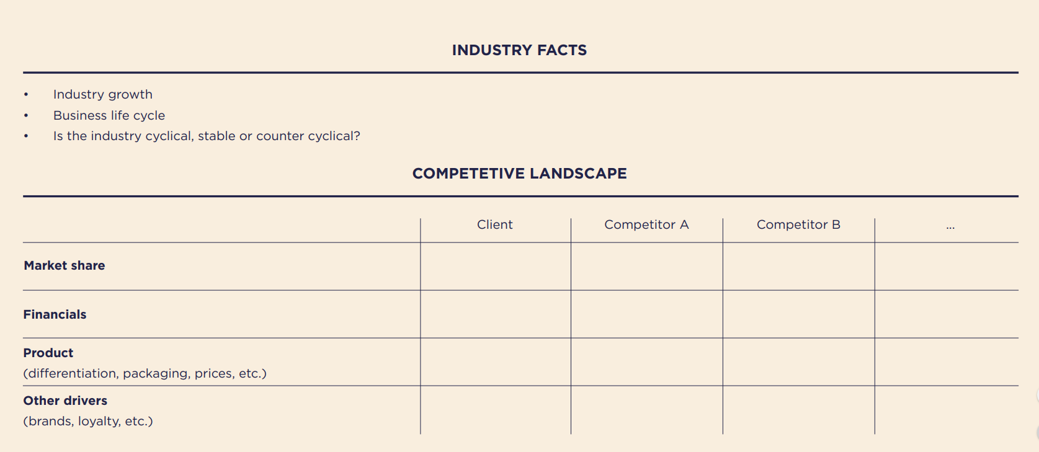
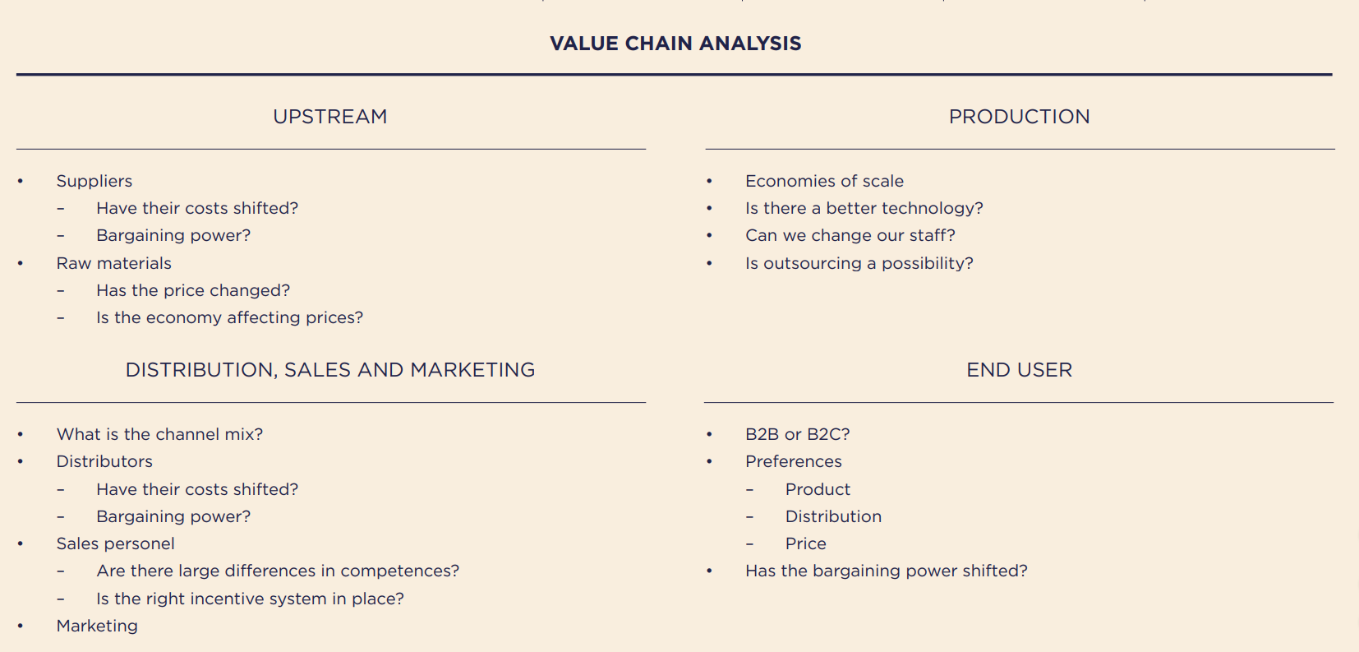
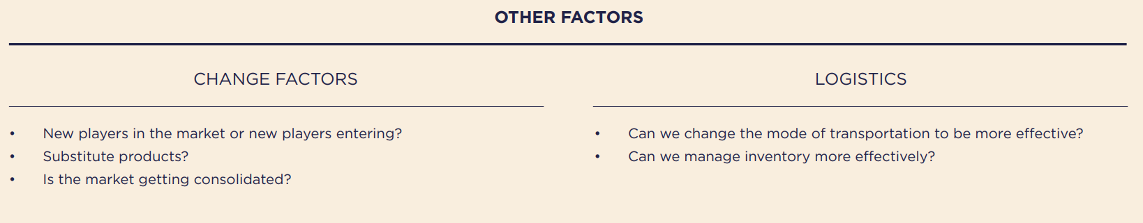
Industry Analysis framework
The industry analysis framework is designed to help you gather information on a company’s external environment. At first glance, it may appear overwhelming but many of the elements are likely already familiar to you.

Slide 9
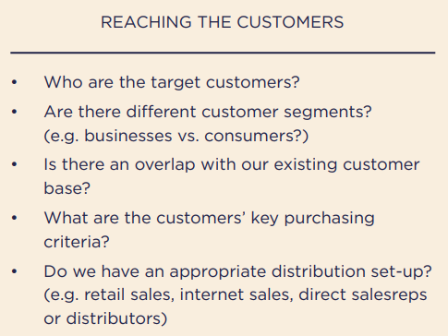
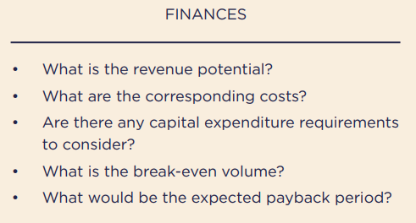
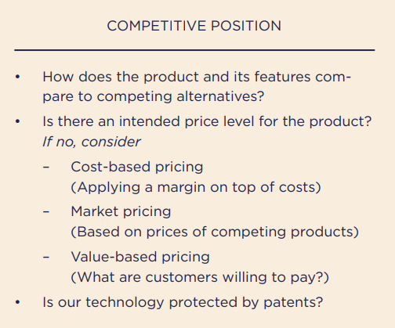
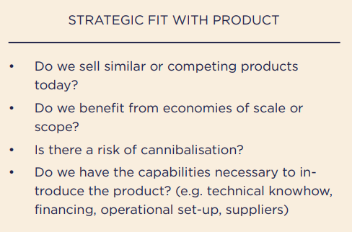
Product Strategy framework
This framework is similar to the industry analysis framework, with some important differences and additional issues. It is a bit more “management consulting” than the others, but nevertheless useful to at least get acquainted with the business

Slide 10
80-20

Slide 11
80-20 a.k.a. Pareto Law
“roughly 80% of consequences come from roughly 20% of the causes”
~20% of landowners own ~80% of the land in Italy
-Wilfredo Pareto
Caveats
Unlike most content in this course this is not actually an universal rule
The specific numbers 80/20 are an approximation to the power law effect: a majority of the output is due to a minority of the input
~20% of pea pods generate ~80% of seeds
-Wilfredo Pareto
Companies make ~80% of their revenue from ~20% of their customers
We wear ~20% of our clothes ~80% of the time
~80% of the world’s income goes to the top ~20% earners

Slide 12
How to exploit Pareto Law
Observation 1: Pareto’s law can be used recursively
Observation 2: The counter reciprocal of Pareto’s law must also hold
Select cautiously
Discard aggressively
Look at a decision tree and select the 20% of nodes where you think you can have the most impact. For the remaining 80% do your due diligence, but don’t focus on them
Even when working in your selected 20%, check if what you are about to sits in the “brings 80% of value” of the particular task - especially if it is complex/time consuming

Slide 13
Prioritization matrixes
The prioritization matrix is one of the simplest, yet one of the most powerful, business analysis tools. In the context of this presentation you can use it to select “your 20%”
Caveats
Watch out for dependencies. Your 20% task may be dependent on a non-20% task
Your “ease of implementation” may not consider all variables (integration, maintenance, change management...)
Your “impact” may not consider all variables (product already sold, unknown business process…)
When in doubt… ask
Impact
Your 20%
Ease of implementation

